Slide 1




A Complete Guide to Programming in C++
Chapter 12 – References and Pointers

Slide 2

Defining References
A reference is another name, or alias, for an object that already exists. Defining a reference does not occupy additional memory. Any operations defined for the reference are performed with the object to which it refers. References are particularly useful as parameters and return values of functions.
The ampersand character, &, is used to define a reference. Given that T is a type, T& denotes a reference to T
rx is thus a different way of expressing the variable x and belongs to the type “reference to float”. Operations with rx, such as
will automatically affect the variable x. The & character, which indicates a reference, only occurs in declarations and is not related to the address operator &! The address operator returns the address of an object. If you apply this operator to a reference, it returns the address of the referenced object.

Slide 3
Defining References
A reference must be initialized when it is declared, and cannot be modified subsequently. In other words, you cannot use the reference to address a different variable at a later stage

Slide 4


Read-Only References
A reference that addresses a constant object must be a constant itself, that is, it must be defined using the const keyword to avoid modifying the object by reference. However, it is conversely possible to use a reference to a constant to address a non-constant object.
The reference cref can be used for read-only access to the variable a, and is said to be a read-only identifier. A read-only identifier can be initialized by a constant, in contrast to a normal reference:
Since the constant does not take up any memory space, the compiler creates a temporary object which is then referenced.

Slide 5
References as Parameters Passing by Reference
A pass by reference can be programmed using references or pointers as function parameters. It is syntactically simpler to use references, although not always permissible.
A parameter of a reference type is an alias for an argument. When a function is called, a reference parameter is initialized with the object supplied as an argument. The function can thus directly manipulate the argument passed to it.
Based on this definition, the statement
increments the variable var. Within the function, any access to the reference a automatically accesses the supplied variable, var. If an object is passed as an argument when passing by reference, the object is not copied. Instead, the address of the object is passed to the function internally, allowing the function to access the object with which it was called.

Slide 6
Comparison to Passing by Value
In contrast to a normal pass by value an expression, such as a+b, cannot be used as an argument. The argument must have an address in memory and be of the correct type.
Using references as parameters offers the following benefits:
arguments are not copied. In contrast to passing by value, the run time of a program should improve, especially if the arguments occupy large amounts of memory
a function can use the reference parameter to return multiple values to the calling function. Passing by value allows only one result as a return value, unless you resort to using global variables.
If you need to read arguments, but not copy them, you can define a read-only reference as a parameter

Slide 7
Comparison to Passing by Value
The function display() contains a string as an argument. However, it does not generate a new string to which the argument string is copied. Instead, str is simply a reference to the argument. The caller can rest assured that the argument is not modified within the function, as str is declared as a const.

Slide 8
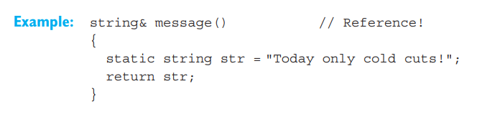
References as Return value
The return type of a function can also be a reference type. The function call then represents an object, and can be used just like an object.
This function returns a reference to a static string, str. Pay attention to the following point when returning references and pointers: The object referenced by the return value must exist after leaving the function.
It would be a critical error to declare the string str as a normal auto variable in the function message(). This would destroy the string on leaving the function and the reference would point to an object that no longer existed.

Slide 9
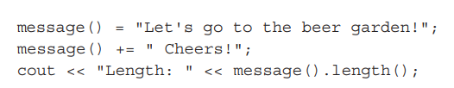
Calling a Reference Type Function
The function message() (mentioned earlier in this section) is of type “reference to string.” Thus, calling message() represents a string type object, and the following statements are valid:
In these examples, a new value is first assigned to the object referenced by the function call. Then a new string is appended before the length of the referenced string is output in the third statement. If you want to avoid modifying the referenced object, you can define the function type as a read-only reference.
References are commonly used as return types when overloading operators. The operations that an operator has to perform for a user-defined type are always implemented by an appropriate function. Refer to the chapters on overloading operators later in this book for more details. However, examples with operators from standard classes can be provided at this point
EXAMPLE: Demonstrating the use of return values with reference type.

Slide 10
Expressions with reference type
Every C++ expression belongs to a certain type and also has a value, if the type is not void. Reference types are also valid for expressions.

Slide 11

The Stream Class Shift Operators
The << and >> operators used for stream input and output are examples of expressions that return a reference to an object.
This expression is not a void type but a reference to the object cout, that is, it represents the object cout. This allows you to repeatedly use the << on the expression
The expression is then equivalent to
Expressions using the << operator are composed from left to right, as you can see from the table of precedence contained in the appendix.

Slide 12

Similarly, the expression cin >> variable represents the stream cin. This allows repeated use of the >> operator.

Slide 13

Other Reference Type Operators
Other commonly used reference type operators include the simple assignment operator = and compound assignments, such as += and *=. These operators return a reference to the operand on the left. In an expression such as a = b or a += b, a must therefore be an object.
In turn, the expression itself represents the object a. This also applies when the operators refer to objects belonging to class types. However, the class definition stipulates the available operators. For example, the assignment operators = and += are available in the standard class string.
Since an expression of this type represents an object, the expression can be passed as an argument to a function that is called by reference.

Slide 14
Defining Pointers
Efficient program logic often requires access to the memory addresses used by a program’s data, rather than manipulation of the data itself. Linked lists or trees whose elements are generated dynamically at runtime are typical examples.
A pointer is an expression that represents both the address and type of another object. Using the address operator, &, for a given object creates a pointer to that object.

Slide 15
Defining Pointers
Given that var is an int variable
is the address of the int object in memory and thus a pointer to var. A pointer points to a memory address and simultaneously indicates by its type how the memory address can be read or written to. Thus, depending on the type, we refer to pointers to char, pointers to int, and so on, or use an abbreviation, such as char pointer, int pointer, and so on.

Slide 16

Pointer Variables
An expression such as &var is a constant pointer; however, C++ allows you to define pointer variables, that is, variables that can store the address of another object.
This statement defines the variable ptr, which is an int* type (in other words, a pointer to int). ptr can thus store the address of an int variable. In a declaration, the star character * always means “pointer to.”

Slide 17
Pointer Variables
Pointer types are derived types. The general form is T*, where T can be any given type. In the above example T is an int type.
Objects of the same base type T can be declared together.
After declaring a pointer variable, you must point the pointer at a memory address

Slide 18
References and Pointers
References are similar to pointers: both refer to an object in memory. However, a pointer is not merely an alias but an individual object that has an identity separate from the object it references. A pointer has its own memory address and can be manipulated by pointing it at a new memory address and thus referencing a different object.
EXAMPLE: Prints the values and addresses of variables.

Slide 19
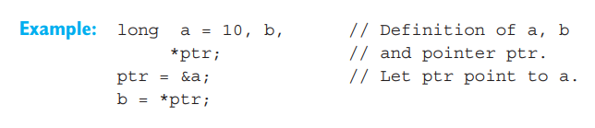
The Indirection Operator
The indirection operator * is used to access an object referenced by a pointer:
Given a pointer, ptr, *ptr is the object referenced by ptr.
As a programmer, you must always distinguish between the pointer ptr and the addressed object *ptr.
This assigns the value of a to b, since ptr points to a. The assignment b = a; would return the same result. The expression *ptr represents the object a, and can be used wherever a could be used.

Slide 20

Using Pointers to Access Objects
The star character * used for defining pointer variables is not an operator but merely imitates the later use of the pointer in expressions. Thus, the definition
has the following meaning: ptr is a long* (pointer to long) type and *ptr is a long type.
The indirection operator * has high precedence, just like the address operator &. Both operators are unary, that is, they have only one operand. This also helps distinguish the redirection operator from the binary multiplication operator *, which always takes two operands.

Slide 21
L-values
An expression that identifies an object in memory is known as an L-value in C++. The term L-value occurs commonly in compiler error messages and is derived from the assignment. The left operand of the = operator must always designate a memory address. Expressions other than an L-value are often referred to as R-values.
A variable name is the simplest example of an L-value. However, a constant or an expression, such as x + 1, is an R-value. The indirection operator is one example of an operator that yields L-values. Given a pointer variable p, both p and *p are L-values, as *p designates the object to which p points.

Slide 22
Objects as Arguments
If an object is passed as an argument to a function, two possible situations occur:
the parameter in question is the same type as the object passed to it. The function that is called is then passed a copy of the object (passing by value)
the parameter in question is a reference. The parameter is then an alias for the argument, that is, the function that is called manipulates the object passed by the calling function (passing by reference).
In the first case, the argument passed to the function cannot be manipulated by the function. This is not true for passing by reference. However, there is a third way of passing by reference—passing pointers to the function.

Slide 23
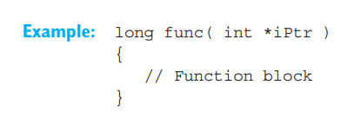
Pointers as Arguments
How do you declare a function parameter to allow an address to be passed to the function as an argument? The answer is quite simple: The parameter must be declared as a pointer variable.
If, for example, the function func() requires the address of an int value as an argument, you can use the following statement
to declare the parameter iPtr as an int pointer. If a function knows the address of an object, it can of course use the indirection operator to access and manipulate the object.

Slide 24
Pointers as Arguments
EXAMPLE: Demonstrates the use of pointers as parameters
In the EXAMPLE, the function swap() swaps the values of the variables x and y in the calling function. The function swap() is able to access the variables since the addresses of these variables, that is &x and &y, are passed to it as arguments
The parameters p1 and p2 in swap() are thus declared as float pointers. The statement swap( &x, &y); initializes the pointers p1 and p2 with the addresses of x or y. When the function manipulates the expressions *p1 and *p2, it really accesses the variables x and y in the calling function and exchanges their values

